Slide 1

Team B
IT Management
Date: 08th FEB. 2023

Slide 2

Types of communication for the website launch project:
Channels:
Face-to-Face: for monthly meeting, UX testing
Telegram: Daily communication, file sending, informal, Daily progress
Email: Formal communicate, Request & Approval
Google Drive: for documents and sharing
Zoom: for Video team meeting

Slide 3
Model:
Web Developer
n(n-1)/2=10
Marketing Specialist
PM
Content Writer
Web Designer

Slide 4

Stakeholders
PM
Web Developer
Web Designer
Content writer
Marketing Specialist
Project owner
Tester
User

Slide 5
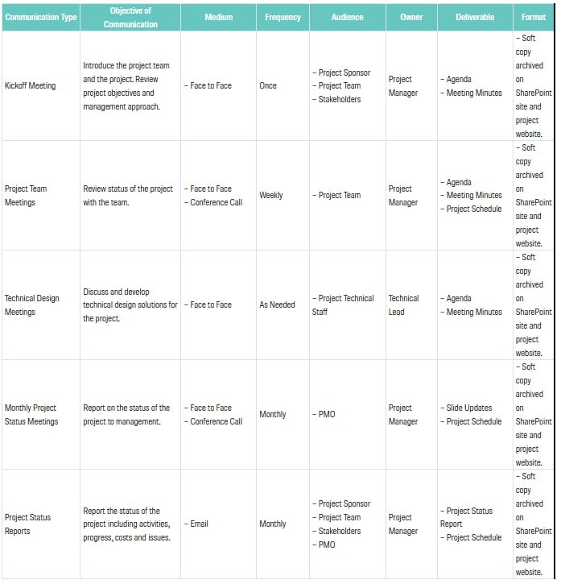
Communication Planning

Slide 6

Objective of the meeting
Method: Face-to-Face, Telegram & Email, Zoom: for Video team meeting

Slide 7

5. Challenges and Risks
Language
Culture
Position
Internet
Computer

Slide 8


